Slide 1
Skin Cancer Detection using Image Processing and Deep Learning
Thesis Presentation

Slide 2
Supervisor: Dr. Md. Ashraful Alam, PhD
Co-advisor: Md. Golam Rabiul Alam, PhD
MEMBERS:
Md. Muzahidul Islam Rahi, 16101111
Farhan Tanvir Khan, 16101099
Mohammad Tanvir Mahtab, 16101125

Slide 3
Datasets
> This the HAM10000 ("Human Against Machine with 10000 training images") dataset. It consists of 10015 dermatoscopic images which are released as a training set for academic machine learning purposes and are publicly available through the ISIC (International Skin Imaging Collaboration) archive. This benchmark dataset can be used for machine learning and for comparisons with human experts.
> The Department of Dermatology at the University of Vienna is equipped with the digital dermoscopy system MoleMax HD (Derma Medical Systems, Vienna, Austria). They extracted cases from this system by filtering SQL-tables with a proprietary tool provided by the manufacturer.
> From the ViDIR Group (Department of Dermatology at the Medical University of Vienna, Austria) data-sources from different times were available and processed after ethics committee approval at the Medical University of Vienna (Protocol-No. 1804/2017).

Slide 4
Datasets
The dataset we will on working on consists of 7 different types of skin diseases with over 10,000 images of skin diseases to train our model on. The 4 ways in which they have accumulated are: histopathology (histo), follow-up examination (follow_up), expert consensus (consensus), or confirmation by in-vivo confocal microscopy (confocal).
The 7 skin diseases we will be working on are:
Melanocytic nevi
Melanoma
Benign keratosis-like lesions
Basal cell carcinoma
Actinic keratoses
Vascular lesions
Dermatofibroma

Slide 5
Our Structure
Step 1. Data analysis and preprocessing
1.1 Importing Essential Libraries
1.2 Making Dictionary of images and labels
1.3 Reading and Processing Data
1.4 Data Cleaning
1.5 Exploratory data analysis (EDA)

Slide 6
Step 1. Data analysis and preprocessing
1.1 The libraries required:
Python Libraries: os, cv2, itertools, matplotlib.pyplot, numpy, panda, seaborn, glob etc.
Pytorch Libraries: torch, torch.autograd, torch.utils.data etc
Sklearn Libraries: sklearn.metrics, sklearn.model_selection
Keras Libraries: keras, keras.utils.np_utils, keras.utils.np_utils, keras.layers.normalization etc

Slide 7
Step 1. Data analysis and preprocessing
1.2 Making Dictionary of images and labels
> In this step I have made the image path dictionary by joining the folder path from base directory base_skin_dir and merge the images in jpg format from both the folders HAM10000_images_part1.zip and HAM10000_images_part2.zip
1.3 Reading & Processing data
> In this step we have read the csv by joining the path of image folder which is the base folder where all the images are placed named base_skin_dir. After that we have made the categorical column cell_type_idx in which we have categorize the lesion type in to codes from 0 to 6

Slide 8
Step 1. Data analysis and preprocessing
1.4 Data Cleaning
> In this step we check for Missing values (null values) and datatype of each field and we will fill the null values by their mean.
> We identify lesion_id's that have duplicate images and those that have only one image and we filter out images that don't have duplicates.

Slide 9
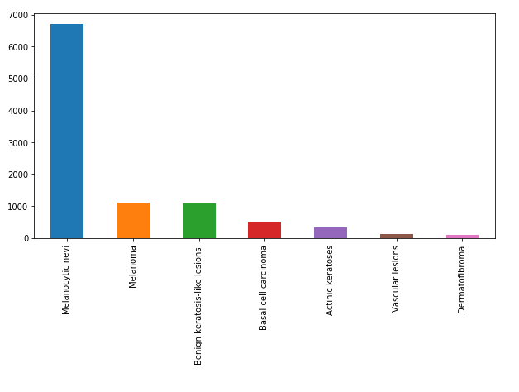
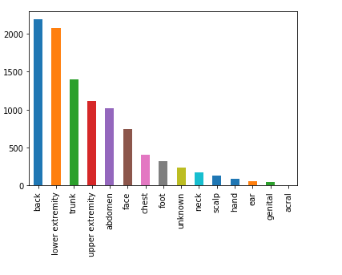
Step 1. Data analysis and preprocessing
1.5 Exploratory data analysis (EDA)
> The distribution of 7 skin cancers > The distribution in different parts of the body

Slide 10
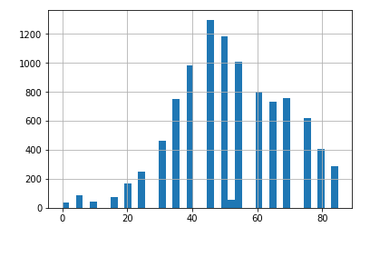
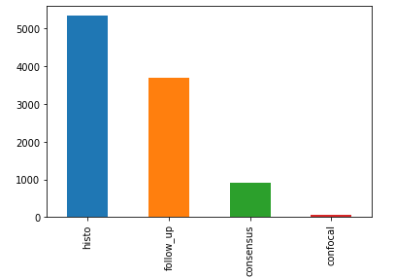
Step 1. Data analysis and preprocessing
1.5 Exploratory data analysis (EDA)
> The distribution of Age > Distribution of 4 different categories

Slide 11
Our Structure
Step 2. Model training
2.1 Loading and resizing of images
2.2 Train Test Split
2.3 Normalization
2.4 Label Encoding
2.5 Splitting training and validation split

Slide 12
Step 2. Model training
2.1 Loading and resizing of images
> In this step images will be loaded into the column named image from the image path from the image folder. We also resize the images as the original dimension of images are 450 x 600 x3 which TensorFlow can't handle, so that's why we resize it into 100 x 75 x 3.
> When using VGG 11 BN (Batch Normalization), we reshaped using 224 x 224 x 3.

Slide 13
Step 2. Model training
2.2 Test-Train Split - We have splitted the dataset into training and testing set of 80:20 ratio
2.3 Normalization - We normalized train set and test set by subtracting from their mean values and then dividing by their standard deviation.
2.4 Label Encoding - Labels are 7 different classes of skin cancer types from 0 to 6
2.5 Splitting training and validation split - We split the train set in two parts : a small fraction (10%) became the validation set which the model is evaluated and the rest (90%) is used to train the model.

Slide 14
Our Structure
Step 3. Model Building
3.1 Using a model
3.2 Setting Optimizer
3.3 Data Augmentation
3.4 Fitting the model

Slide 15
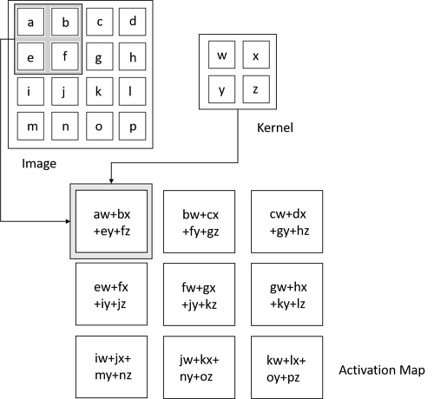
3.1 Model Building - CNN (Keras Sequential API)
The first is the convolutional (Conv2D) layer. It is like a set of learnable filters. We used 32 filters for the two firsts conv2D layers and 64 filters for the two last ones. Each filter transforms a part of the image (defined by the kernel size) using the kernel filter. The kernel filter matrix is applied on the whole image. Filters can be seen as a transformation of the image.
The CNN can isolate features that are useful everywhere from these transformed images (feature maps).
Figure : Convolution Operation (Source: Deep Learning by Ian Goodfellow, Yoshua Bengio, and Aaron Courville)

Slide 16
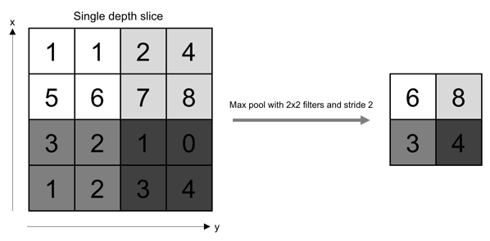
CNN
The second important layer in CNN is the pooling (MaxPool2D) layer. This layer simply acts as a downsampling filter. It looks at the 2 neighboring pixels and picks the maximal value. These are used to reduce computational cost, and to some extent also reduce overfitting. We have to choose the pooling size (i.e the area size pooled each time) more the pooling dimension is high, more the downsampling is important.
Combining convolutional and pooling layers, CNN are able to combine local features and learn more global features of the image.
Figure : Pooling Operation (Source: O'Reilly Media)

Slide 17
CNN
> The Flatten layer is use to convert the final feature maps into a one single 1D vector. This flattening step is needed so that you can make use of fully connected layers after some convolutional/maxpool layers. It combines all the found local features of the previous convolutional layers.
> ReLU: Abbreviation of “The Rectified Linear Unit” calculates the function ƒ(κ)=max (0,κ). The activation is threshold at zero. ReLU is more reliable and the convergence is much faster (by six fold). And this is what we have used in our thesis. A problem might occur during the training stage if a large gradient flows such that it updates it such that the neuron never gets further updated. We have worked around this by setting a suitable learning rate.
> We used the features in two fully-connected (Dense) layers which is just artificial neural networks (ANN) classifier. In the last layer(Dense(10,activation="softmax")) the net outputs distribution of probability of each class.

Slide 18
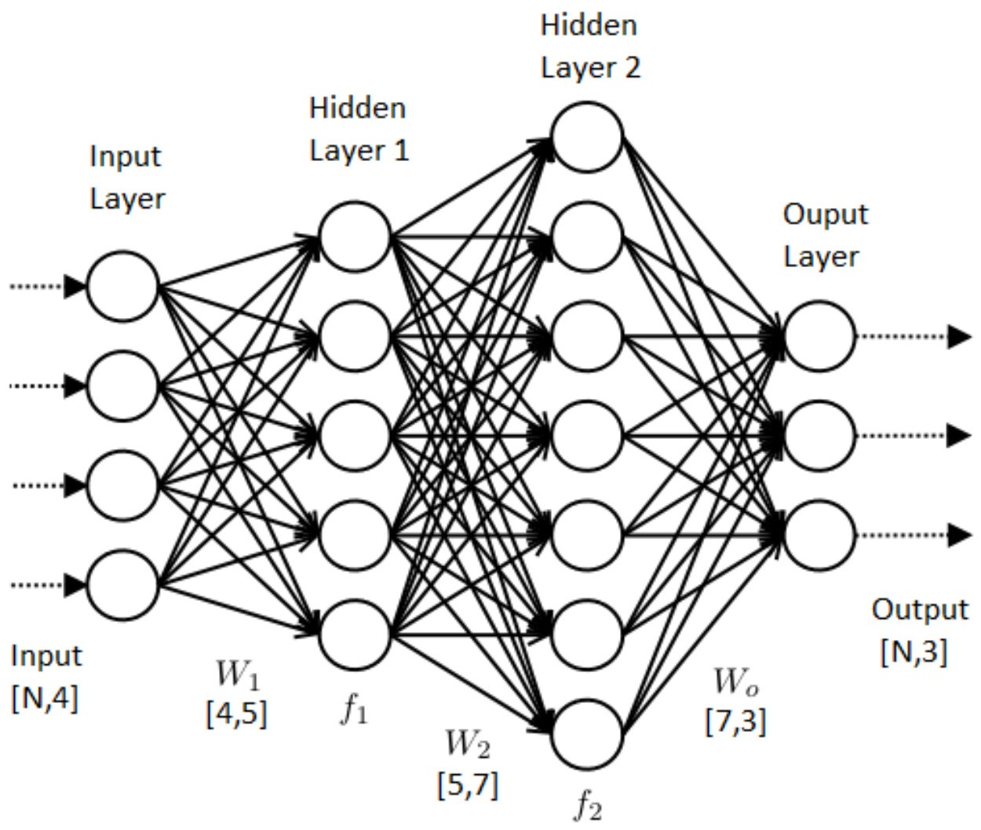
ANN (Artificial Neural Network)
Figure: A model describing forward and backward propagation (Source: Data Science Central)

Slide 19
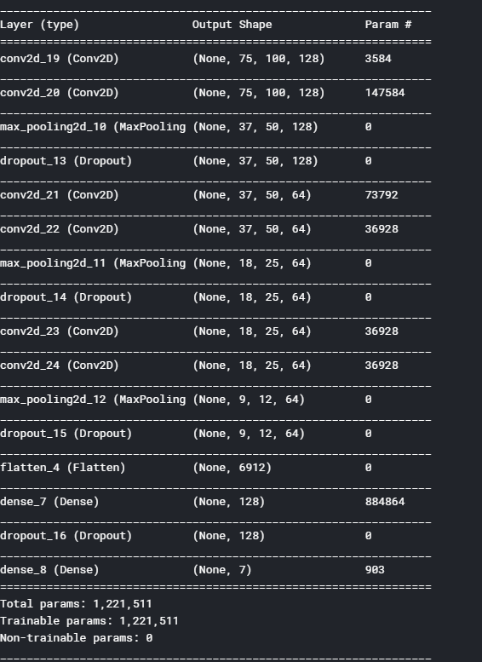
CNN

Slide 20
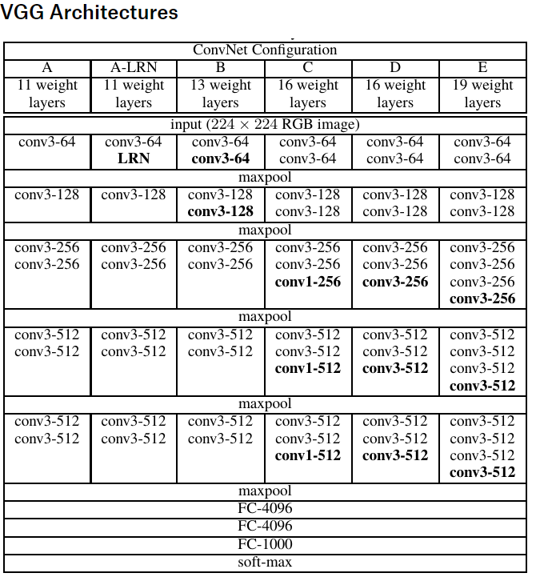
VGG 11 BN (Batch Normalization)
> VGG-11 already obtains 10.4% error rate. VGG uses pre trained data to increase accuracy

Slide 21
Step 3. Model Building
3.2 Setting Optimizer and Annealer
> We have used ADAM Optimizer for both the models
> The Adam optimization algorithm is an extension to stochastic gradient descent that has recently seen broader adoption for deep learning applications in computer vision and natural language processing.
> This function will iteratively improve parameters (filters kernel values, weights and bias of neurons) in order to minimise the loss percentage.

Slide 22
Step 3. Model Building
3.3 Data Augmentation
> In order to avoid overfitting problem, we need to expand artificially our HAM 10000 dataset. We can make your existing dataset even larger.
> Some popular augmentations people use are grayscales, horizontal flips, vertical flips, random crops, color jitters, translations, rotations etc
> Randomly rotate some training images by 10 degrees Randomly Zoom by 10% some training images Randomly shift images horizontally by 10% of the width Randomly shift images vertically by 10% of the height. Once our model is ready, we fit the training dataset

Slide 23
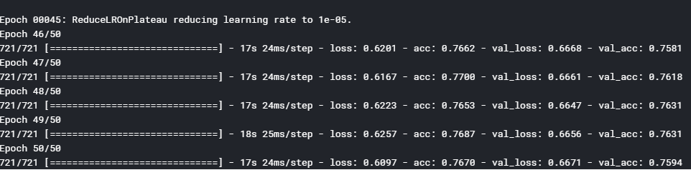

3.4 CNN

Slide 24
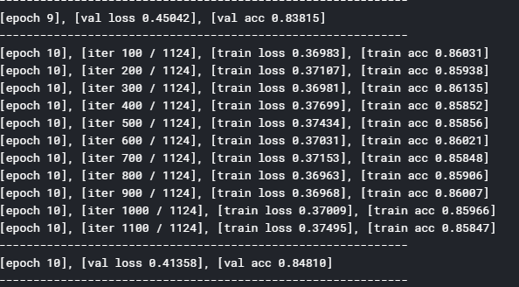
VGG

Slide 25
Our Structure
Step 4. Model Evaluation
4.1 Confusion Matrix
4.2 Precision
4.3 Recall
4.4 F1-score
4.5 Support

Slide 26
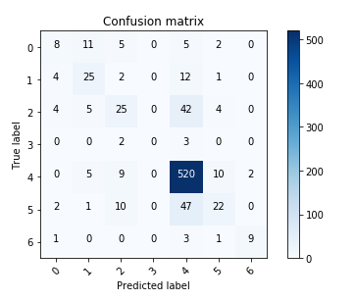
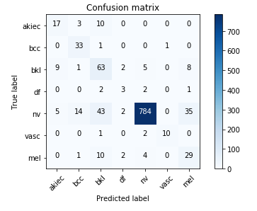
Step 4. Model Evaluation 4.1 Confusion Matrix
CNN VGG11

Slide 27
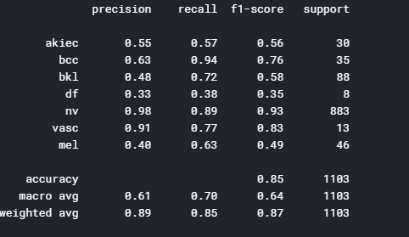
VGG

Slide 28
Conclusion
>Using pre trained data and models like VGG, we can have more accuracy.
>We would like to use RESNET50, DENSENET-121 and GoogleNet(Inception).
>We will show graphs of loss accuracy and validation accuracy etc.

